Slide 1
Key Dates & Information for FY25 Year End Close
Presented by:
Joyce Chavez, Associate Controller
HSC Unrestricted Accounting
June 5, 2025

Slide 2
Tips for Meeting PCard Deadlines
Check your CR EWallet daily.
Be sure to read PCard department emails. These are currently being sent daily to alert you to new items that need to be reconciled.

Slide 3
Tips for Meeting PCard Deadlines
Complete
PCard purchases
on or before June 27.

Slide 4
Pcard Deadlines
PCard Report Deadlines
Departments must submit AND approve PCard Reports on or before July 6.
* * * * *
For transactions with a transaction date through 6/30/2025

Slide 5
Pcard Reminders
PCard Reports
Do not mix FY25 and FY26 purchases on the same report. Each report should contain only purchases from the same FY.
* * * * *
Include “FY25” or “FY26” in the name of your report.

Slide 6
Chrome River
CR Expense/Invoice Report Deadlines
Departments must submit on or before June 30.
* * * * *
Departments must approve on or before July 7.

Slide 7
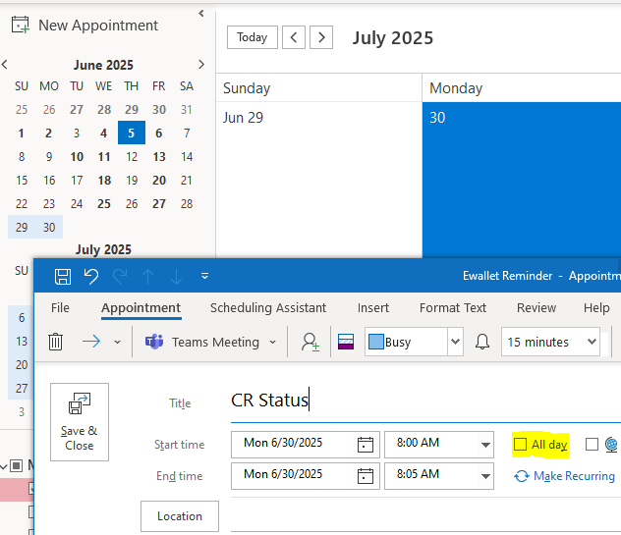
Tips for Meeting CR Deadlines
Add a daily reminder to your calendar to check on the status of all CR Reports.
Open Outlook Calendar
-Double-click on the date you want to set a remind for
-Add your “title”
-Ensure the “All day” is not selected
-Select start and end time
-Click on “Make Recurring” to continue the reminder choose the days that you want to be reminded

Slide 8
Journal Voucher Deadlines
Departments must submit AND approve Journal Vouchers by 5:00 p.m. July 7. Documents must be back dated to June 30th if created between 7/1-7/7 for FY25.
* * * * * *
Departments will have no ability to submit JVs from 5:01 p.m. July 7 to 8:00 a.m. July 18. After July 7th, any material adjustments must be initiated by SOM or HSC Unrestricted Accounting.

Slide 9
PHAREDS Deadlines
LABOR REDISTRIBUTIONS must be completed by 5:00 p.m. July 7.
LABOR REDISTRIBUTIONS access is removed from 5:01 p.m. July 7 to 8:00 a.m. July 18.

Slide 10
LoboMart Deadlines
LoboMart Requisitions for FY25 for $5,000 or less must be completed and approved by departments by June 6.
FY26 LoboMart Requisitions can be created at this time.

Slide 11
NSAR Billing Deadlines
All invoicing for FY25 must be entered by noon June 30.
NSAR backup must be emailed to HSC Unrestricted Accounting by noon June 30.
Ensure that NSAR users close their sessions

Slide 12
Year-End Recap
Important Dates
Helpful Tips

Slide 13
Department Deadlines by Date
Deadline | Transactions
June 6 | All PR ≤ $5,000 approved
June 30 | CR Expense/Invoice submitted
 | NSAR invoicing completed by noon; all backup to Unrestricted Accounting by noon. Ensure to “close session”
June 30 by noon | Money lists with cash, checks, daily confirmation letters, and petty cash reimbursements due to Bursar
July 1 | Last day to submit vendor invoices to A/P for FY25 payment
July 6 | Submit AND approve Pcard Reports

Slide 14
Department Deadlines by Date
Date | Transactions
July 7 | CR Expense/Invoice reports approved by department
 | JVs submitted AND approved by department
 | PHAREDS completed
July 7 – 11 | Submit request for material YE JV to Financial Services or SOM
July 7 5:01pm to July 18 8am | Departments cannot key JVs or PHAREDS

Slide 15
Department Deadlines by Date
Other Important Dates
Accounts Payable last day to cut checks for FY25 is 7/10
* * * * * *
Final FY25 MyReports will be available on 7/22
* * * * * *
Financial Services Support Center information will email periodic reminders on key dates.

Slide 16
Additional Year-end Close Tasks
Different from month end close
Accrual Entries
Completion of Purchase Orders & Invoices
Annual adjustments
Catastrophic Leave Donation
Annual Leave Accrual
Endowment true-ups to market value
Endowed Spending index distributions
NSAR backup must be emailed to HSC Unrestricted Accounting by noon June 30.
Ensure that NSAR users close their sessions

Slide 17
Finding the Approval Status of Chrome River Expense/Invoice Reports

Slide 18
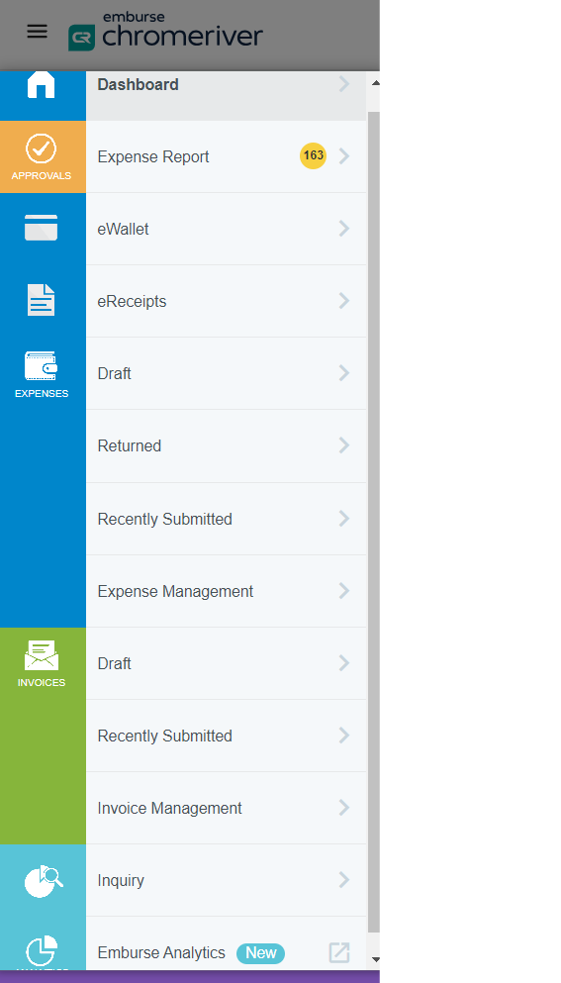
Finding Approval Status
In Chrome River, click on “Emburse Analytics.” When that page comes up click “All.”

Slide 19
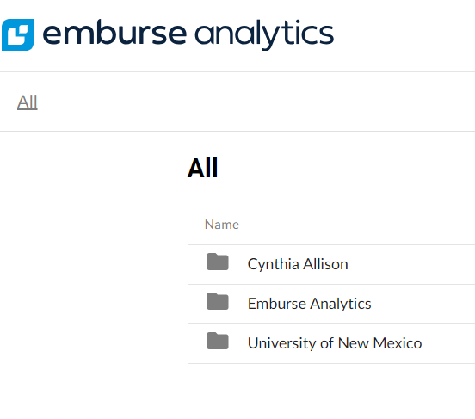
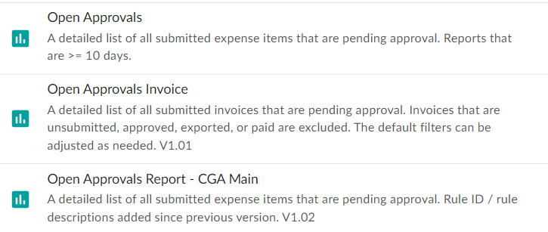
Finding Approval Status
Choose University of New Mexico. You will see an Open Approvals report for CR Expense and Open Approvals Invoice for CR invoice. These reports can be filtered for your org. and/or number of days they’ve been waiting on approvals.

Slide 20
How to Filter Open Approval Report
Click the triangle to expand fields that can be customized for your reporting needs.

Slide 21
Reporting Filter Options –Part 1

Slide 22
Reporting Filter Options –Part 2

Slide 23
Export Data Set for Analysis

Slide 24
Final Tip
If you haven’t reviewed and reconciled your indexes …
DO IT NOW!

